Slide 1
Pintos Project 4
File Systems
November 14, 2016

Slide 2
Overview

Slide 3
Requirements
Implementation
Project 4 will be done in src/filesys/
This means you will run make in src/filesys
This means you will run tests in vm/build
DesignDoc
Project 4 design document can be found in doc/vm.tmpl
Rename the design document as DESIGNDOC and place in src/filesys.
Naming
Please name your project 4 directory “proj4” in your repository. Also please name your design document “DESIGNDOC”

Slide 4
Overview
This project aims you to build a robust filesystem for Pintos
Part 1: Indexed and Extensible Files
Implements inode (direct, indirect, doubly-indirect) extension functionality
Part 2: Nested Directories
Basically folders. You’ll need to do filename parsing as well as change some structs
Part 3: Buffer Cache
A cache of file blocks, basically a simple version for project 3 but for files

Slide 5
Prerequisites
Setup proj4 Directory
Copy proj2/ into proj4/
Copy proj3/ into proj4/
If you use this option make sure to setup the Make.vars to enable virtual memory
Of the 121 tests for project 4, 62 of those tests are the exact same as the tests in project 2.
Add New Files to Makefile.build
Under the appropriate section add the paths to your new .c files.

Slide 6
Recommended Order of Implementation
The Stanford website recommends:
Buffer Cache -> Extensible Files -> Nested Directories
We recommend:
Extensible Files -> Nested Directories -> Buffer Cache
Look into both before starting!

Slide 7
Part 1
Indexed and Extensible Files

Slide 8
Overview
You will need to use an indexing structure with direct, indirect, and doubly-indirect blocks to resolve external fragmentation
File system partition is 8MB, meaning you will need at minimum one doubly-indirect block
Once you finish indexing implementation, growing files will be easier

Slide 9
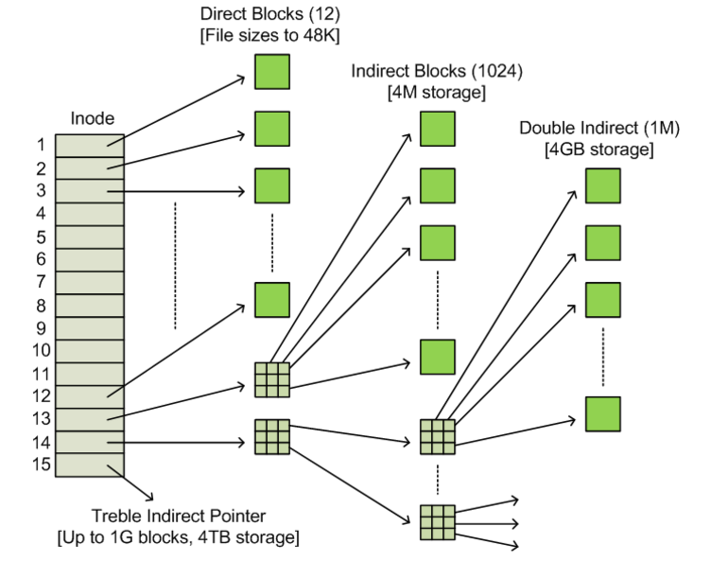

Slide 10
Notes on Indexed Files
You will need to make a lot of changes to struct inode_disk and struct inode to support indexing
Creating a file starts off with a size of 0, then expand the file everytime a write read goes beyond the file.
Large files with small of data should be filled with 0’s
Seek and reads past EOF do not extend the file

Slide 11
Part 2
Nested Directories

Slide 12
Overview
Currently there is only one directory (the root directory) with no support for subdirectories
You will need to allow directory entries to point to files or other directories
File syscalls need to be updated to handle directories with absolute or relative path names.
You will need to parse the filenames to know the path of a file

Slide 13
Notes on Nested Directories
Keep track of the type of file (directory or an actual file)
Directories should extend beyond their 16 file limit (supporting indexed and extensible files should allow this to work)
Support . and ..
Support absolute and relative path names
Implement new syscalls readdir, mkdir, rmdir
Validate directories, keep track of the current directory, and handle deleting any open or current directories

Slide 14
Part 3
Buffer Cache

Slide 15
Overview
Cache accesses disk blocks in memory
This cache should be the only entity interfacing with the disk
System Calls
file_*()
inode_*()
cache_*()
disk_*()
File System Utilities
dir_*()
You’ll need to implement this!

Slide 16
64 Blocks in Cache
struct
512 bytes
You’ll want to keep track of some information for each block, eg:
Disk_sector_id
Pointer to the data
Dirty & valid bit
# readers / writer
# of pending read / write requests
Lock for synchronization
Info for eviction policy
struct
512 bytes
struct
512 bytes
struct
.
.
.
.
.
512 bytes
struct
512 bytes

Slide 17
Notes on Buffer Cache
A static array of 64 blocks is fine
Creating a cache.h and .c will be helpful to maintain the modularity (much like project 3)
Synchronize on per-block basis
LRU eviction policy is just fine
Make sure to implement read-ahead and write-behind\
Need to support multiple readers & writers

Slide 18
Questions & Concerns?

